Slide 1

Airlines for business travel
Avoid flight delays with InformatiTEK
Presented by: Hannah McElroy
May 6, 2021

Slide 2

Introduction
Hannah McElroy
TEKsystems
Data Analytics Boot Camp Class Member
Airlines for Business Travel Project
Data Engineering
Data Analytics & Insights

Slide 3



Airline for Business Travel Problem & Solution
InformatiTEK will provide analytics & insights on airlines to travel with for business
For those who travel for business, flying back and forth to work can be very time-consuming.
InformatiTEK can approach this problem by: ​
Data gathering from reputable data sources​
Data preparation
Airline dashboard

Slide 4


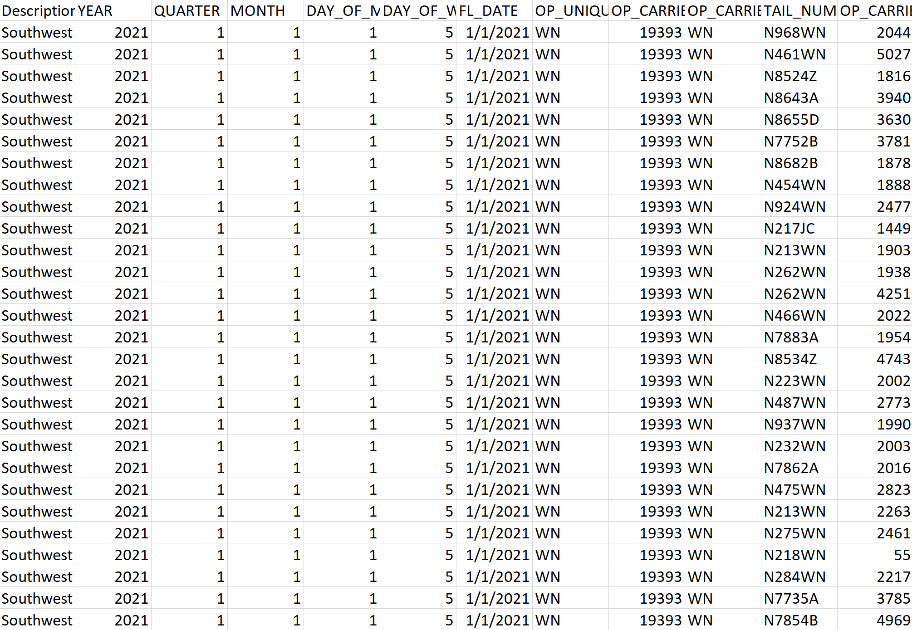
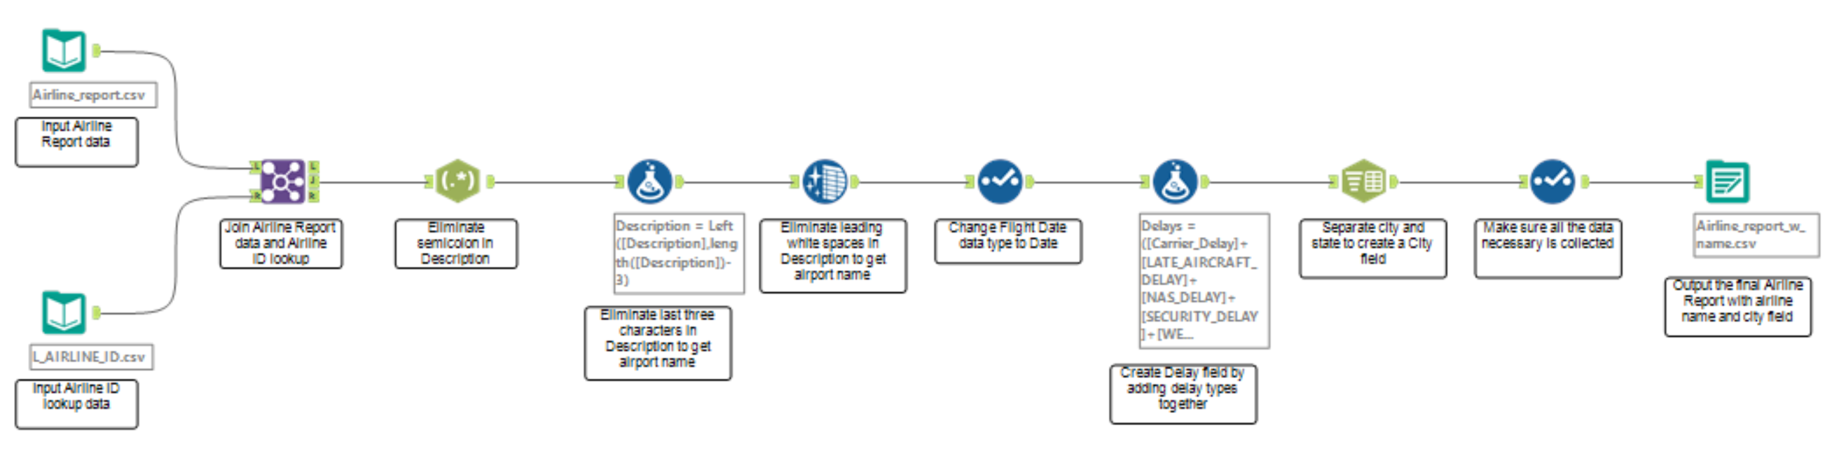

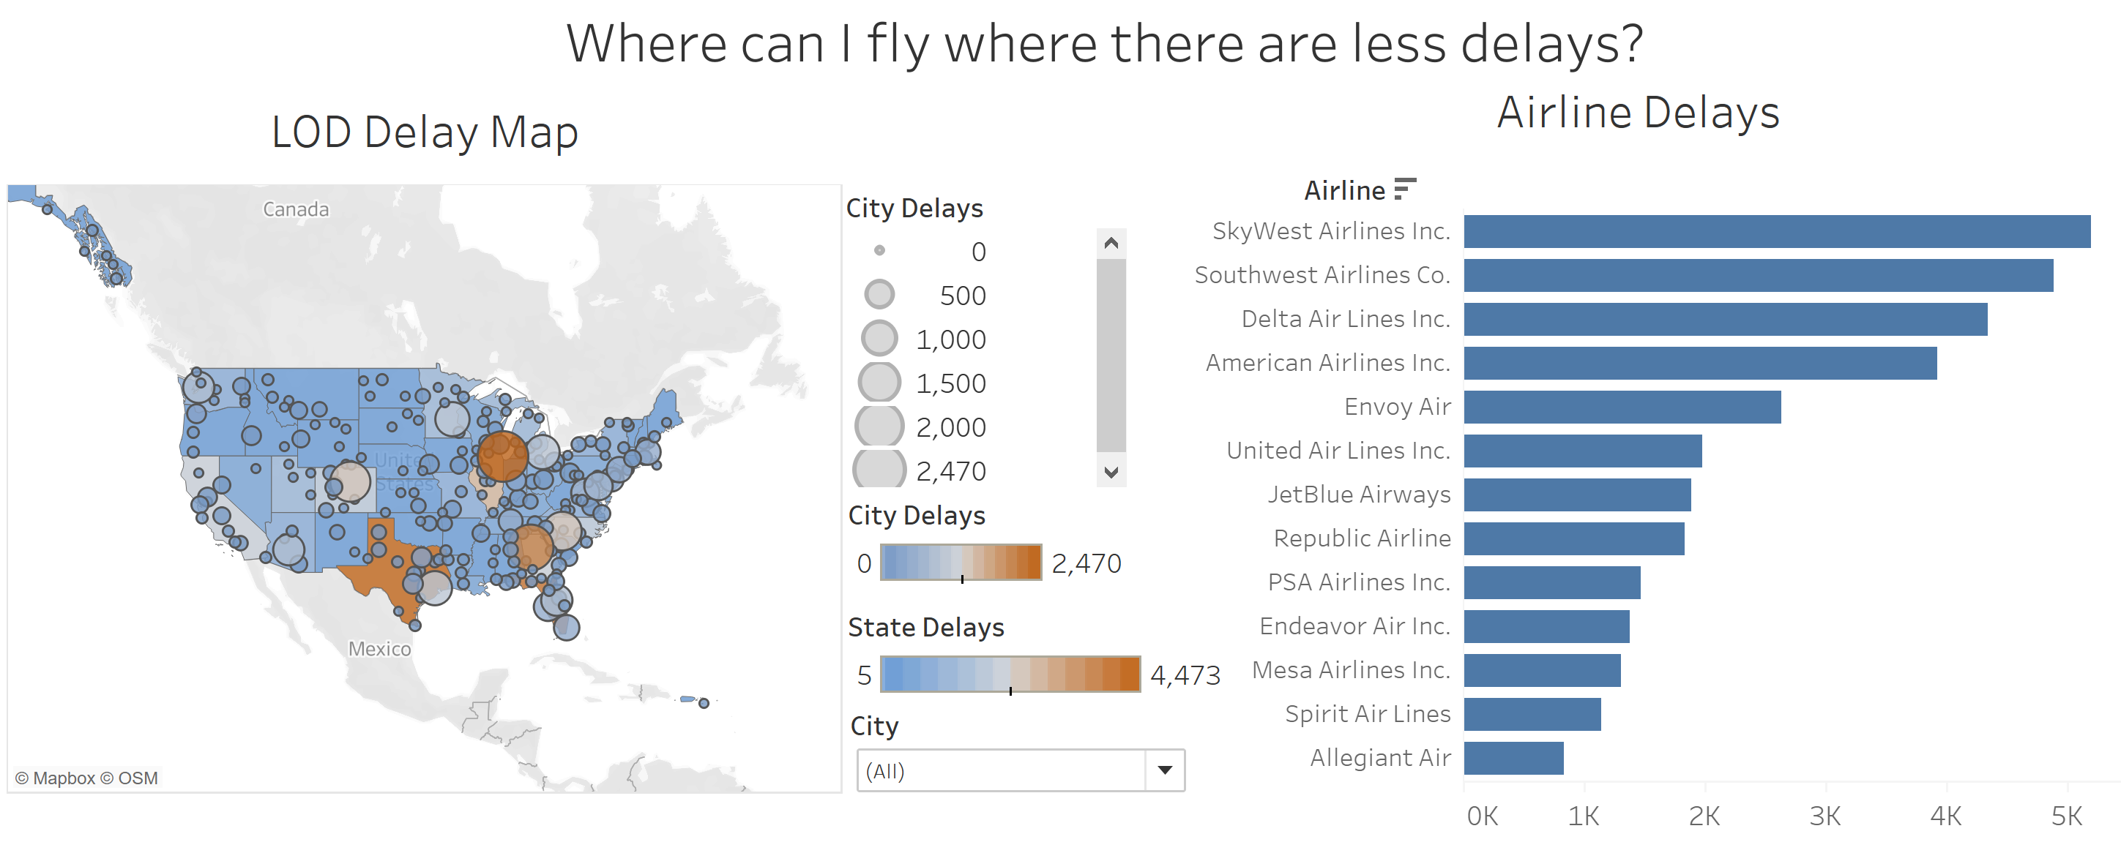
Process
What steps were taken to provide insights on this problem?

Slide 5
Data Sources
Bureau of Transportation Statistics (BTS)
Part of the Department of Transportation (DOT)
Accessible information on the U.S.’s transportation system
Collects and updates statistical information every month

Slide 6
Alteryx Workspace
Data Cleansing and Preparation

Slide 7
Questions
Hannah McElroy

